Slide 1

Chapter 11:
Structured Data

Slide 2

Abstract Data Types
Abstract data types are data types created by the programmer.
Abstract data type that specifies
  values that can be stored
  operations that can be done on the values
User of an abstract data type does not need to know the implementation of the data type, e.g., how the data is stored

Slide 3
Combining Data into Structures
Structure: C++ construct that allows multiple variables to be grouped together
General Format:
  struct <structName>
  {
  type1 field1;
  type2 field2;
  . . .
  };

Slide 4
Example struct Declaration
  struct Student
  {
  int studentID;
  string name;
  short yearInSchool;
  double gpa;
  };
structure tag
structure members

Slide 5
struct Declaration Notes
Must have ; after closing }
struct names commonly begin with uppercase letter
Multiple fields of same type can be in comma-separated list:
  string name,
  address;

Slide 6
Defining Variables
struct declaration does not allocate memory or create variables
To define variables, use structure tag as type name:
  Student bill;
bill
studentID
name
yearInSchool
gpa

Slide 7
Accessing Structure Members
Use the dot (.) operator to refer to members of struct variables:
  cin >> stu1.studentID;
  getline(cin, stu1.name);
  stu1.gpa = 3.75;
Member variables can be used in any manner appropriate for their data type

Slide 8
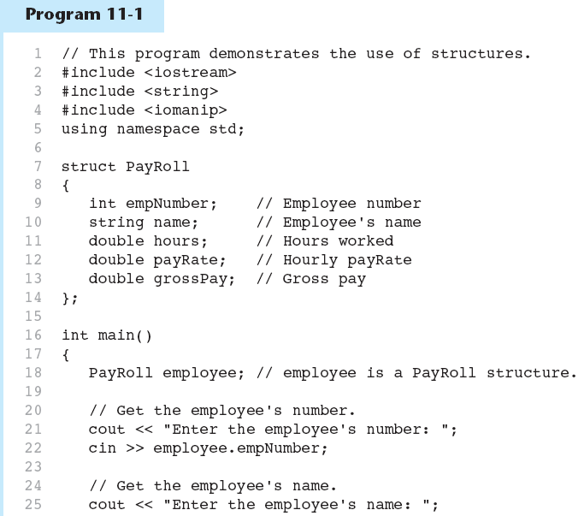

Slide 9
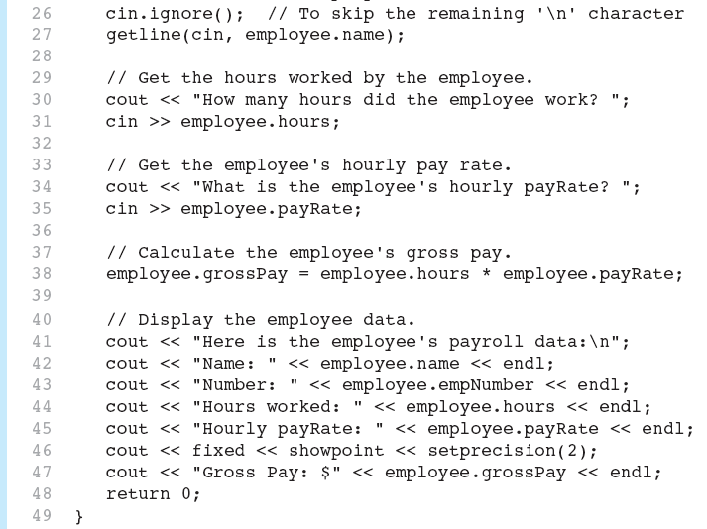

Slide 10
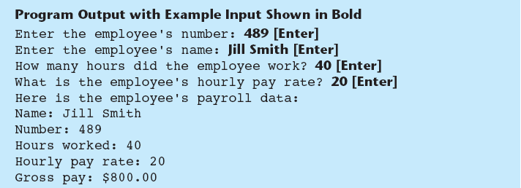

Slide 11
Displaying a struct Variable
To display the contents of a struct variable, must display each field separately, using the dot operator:
  cout << bill; // won’t work
  cout << bill.studentID << endl;
  cout << bill.name << endl;
  cout << bill.yearInSchool;
  cout << " " << bill.gpa;

Slide 12
Comparing struct Variables
Cannot compare struct variables directly:
  if (bill == william) // won’t work
Instead, must compare on a field basis:
  if (bill.studentID ==
  william.studentID) ...

Slide 13
11.4
Initializing a Structure

Slide 14
Initializing a Structure
struct variable can be initialized when defined:
  Student s = {11465, "Joan", 2, 3.75};
Can also be initialized member-by-member after definition:
  s.name = "Joan";
  s.gpa = 3.75;

Slide 15
More on Initializing a Structure
struct Student
{
int studentID;
string name;
short yearInSchool;
double gpa;
};
May initialize only some members:
  Student bill = {14579};
Cannot skip over members:
  Student s = {1234, "John", ,2.83}; // illegal
Cannot initialize in the structure declaration, since this does not allocate memory
struct CitynInfo
{
string cityName = “Peoria”; //ERROR
string state = “IL”; //ERROR
long population = 50000; //ERROR
int distance = 28; //ERROR
};

Slide 16
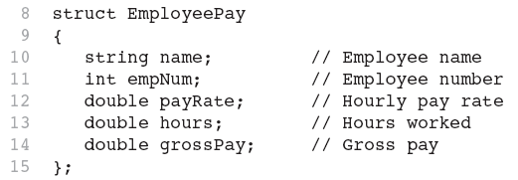
Excerpts From Program 11-3

Slide 17
Exercise
When completer the following program, asks the user to enter these data about his or her favorite movies:
  Name of movie
  Name of movie’s director
  Name of movie’s producer
  The year the movie was released
Declare the structure that holds this data, defining a structure variable, and write the individual statements necessary, enter the data until the user enters ‘quit’. Finally display all information to screen.

Slide 18
11.5
Arrays of Structures

Slide 19
Arrays of Structures
Structures can be defined in arrays
Can be used in place of parallel arrays
const int NUM_STUDENTS = 20;
Student stuList[NUM_STUDENTS];
Individual structures accessible using subscript notation
Fields within structures accessible using dot notation:
  cout << stuList[5].studentID;

Slide 20
Arrays of Structures example
Struct BookInfo
{
string title;
string author;
double price;
}
BookInfo booklist[10];
for(int i=0; i<10; i++)
{
cout << booklist[i].title << endl;
cout << booklist[i].author << endl;
cout << booklist[i].price << endl;
}

Slide 21
11.6
Nested Structures

Slide 22
Nested Structures
A structure can contain another structure as a member:
  struct PersonInfo
  { string name,
  address,
  city;
  };
  struct Student
  { int studentID;
  PersonInfo pData;
  short yearInSchool;
  double gpa;
  };

Slide 23
Members of Nested Structures
Use the dot operator multiple times to refer to fields of nested structures:
  Student s;
  s.pData.name = "Joanne";
  s.pData.city = "Tulsa";

Slide 24
11.7
Structures as Function Arguments

Slide 25
Structures as Function Arguments
May pass members of struct variables to functions:
  computeGPA(stu.gpa);
May pass entire struct variables to functions:
  showData(stu);
Can use reference parameter if function needs to modify contents of structure variable

Slide 26
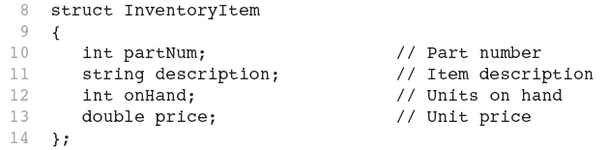
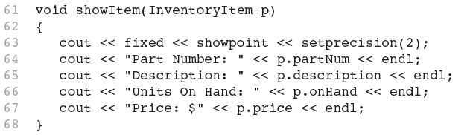
Excerpts from Program 11-6
void main()
{
InventoryItem item;
item.partNum = 120;
item.description = “Smart Keys”;
item.onHand = 10;
item.price = 200;
showItem(item);
}

Slide 27
Structures as Function Arguments - Notes
Using value parameter for structure can slow down a program, waste space
Using a reference parameter will speed up program, but function may change data in structure
Using a const reference parameter allows read-only access to reference parameter, does not waste space, speed

Slide 28
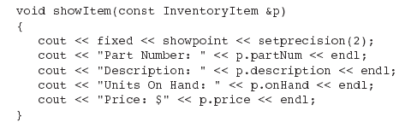
Revised showItem Function

Slide 29
11.8
Returning a Structure from a Function

Slide 30
Returning a Structure from a Function
Function can return a struct:
  Student getStudentData(); // prototype
  stu1 = getStudentData(); // call
Function must define a local structure
  for internal use
  for use with return statement

Slide 31
Returning a Structure from a Function - Example
  Student getStudentData()
  {
  Student tempStu;
  cin >> tempStu.studentID;
  getline(cin, tempStu.pData.name);
  getline(cin, tempStu.pData.address);
  getline(cin, tempStu.pData.city);
  cin >> tempStu.yearInSchool;
  cin >> tempStu.gpa;
  return tempStu;
  }

Slide 32
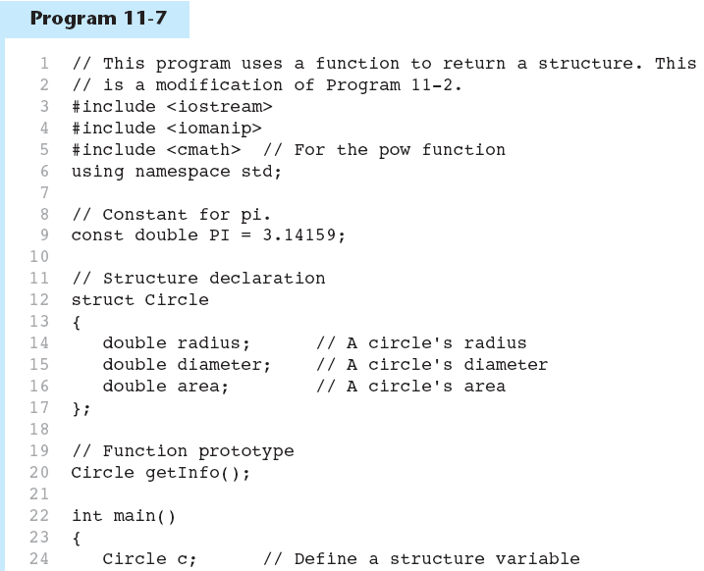

Slide 33
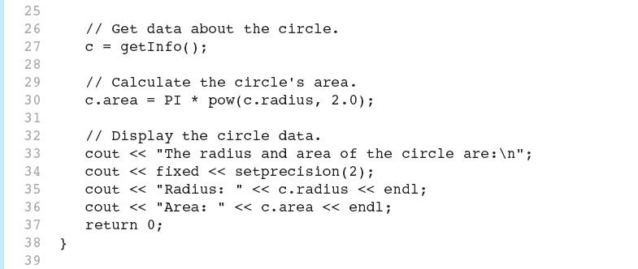

Slide 35
Lab 11
Write a program that uses a structure to store the following data about a customer account:
  Name
  Address
  City, State, and ZIP
  Phone number
  Account Balance
  Data of Last Payment
The program should use an array of at least 10 structures, it should let the user enter data into the array, change the contents of any element, and display all the data stored in the array. The program should have a menu-driven user interface.
Input validation: when the data for a new account is entered, be sure the user enters data for all the field. No negative account balances should be entered.
Add a function that allows the user to search the structure array for a particular customer’s account. It should accept part of the customer’s name as an argument and then search for an account with a name that matches it. All accounts that match should be displayed. Of no account matches, a message saying so should be displayed.

Slide 36
// Function getInfo gets account information from the user and stores it in the parameter, which //is a Customer structure reference variable.
/Function showInfo displays the customer's name, address, account balance, and date of
// last payment. The information is passed into the c structure.
// Function prototypes
void getInfo(Customer &);
void showInfo(Customer);
// Display a menu.
cout << "1. Enter new account information\n";
cout << "2. Change account information\n";
cout << "3. Display all account information\n";
cout << "4. Exit the program\n\n";

Slide 37
11.9
Pointers to Structures

Slide 38
Pointers to Structures
A structure variable has an address
Pointers to structures are variables that can hold the address of a structure:
  Student *stuPtr;
Can use & operator to assign address:
  stuPtr = & stu1;
Structure pointer can be a function parameter

Slide 39
Accessing Structure Members via Pointer Variables
Must use () to dereference pointer variable, not field within structure:
  cout << (*stuPtr).studentID;
Can use structure pointer operator to eliminate () and use clearer notation:
  cout << stuPtr->studentID;

Slide 40
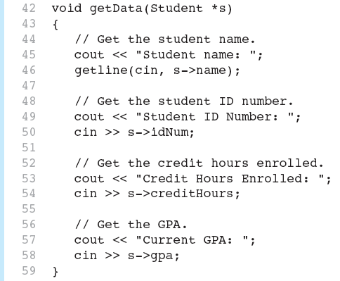
From Program 11-8

Slide 41
11.12
Enumerated Data Types

Slide 42
Enumerated Data Types
An enumerated data type is a programmer-defined data type. It consists of values known as enumerators, which represent integer constants.

Slide 43
Enumerated Data Types
Example:
enum Day { MONDAY, TUESDAY,
WEDNESDAY, THURSDAY,
FRIDAY };
The identifiers MONDAY, TUESDAY, WEDNESDAY, THURSDAY, and FRIDAY, which are listed inside the braces, are enumerators. They represent the values that belong to the Day data type.

Slide 44
Enumerated Data Types
enum Day { MONDAY, TUESDAY,
WEDNESDAY, THURSDAY,
FRIDAY };
Note that the enumerators are not strings, so they aren’t enclosed in quotes. They are identifiers.

Slide 45
Enumerated Data Types
Once you have created an enumerated data type in your program, you can define variables of that type. Example:
Day workDay;
This statement defines workDay as a variable of the Day type.

Slide 46
Enumerated Data Types
We may assign any of the enumerators MONDAY, TUESDAY, WEDNESDAY, THURSDAY, or FRIDAY to a variable of the Day type. Example:
workDay = WEDNESDAY;

Slide 47
Enumerated Data Types
So, what is an enumerator?
Think of it as an integer named constant
Internally, the compiler assigns integer values to the enumerators, beginning at 0.

Slide 48
Enumerated Data Types
enum Day { MONDAY, TUESDAY,
WEDNESDAY, THURSDAY,
FRIDAY };
In memory...
MONDAY = 0
TUESDAY = 1
WEDNESDAY = 2
THURSDAY = 3
FRIDAY = 4

Slide 49
Enumerated Data Types
Using the Day declaration, the following code...
cout << MONDAY << " "
<< WEDNESDAY << " “
<< FRIDAY << endl;
...will produce this output:
0 2 4

Slide 50
Assigning an integer to an enum Variable
You cannot directly assign an integer value to an enum variable. This will not work:
workDay = 3; // Error!
Instead, you must cast the integer:
workDay = static_cast<Day>(3);

Slide 51
Assigning an Enumerator to an int Variable
You CAN assign an enumerator to an int variable. For example:
int x;
x = THURSDAY;
This code assigns 3 to x.

Slide 52
Comparing Enumerator Values
Enumerator values can be compared using the relational operators. For example, using the Day data type the following code will display the message "Friday is greater than Monday.“
if (FRIDAY > MONDAY)
{
cout << "Friday is greater "
<< "than Monday.\n";
}

Slide 53
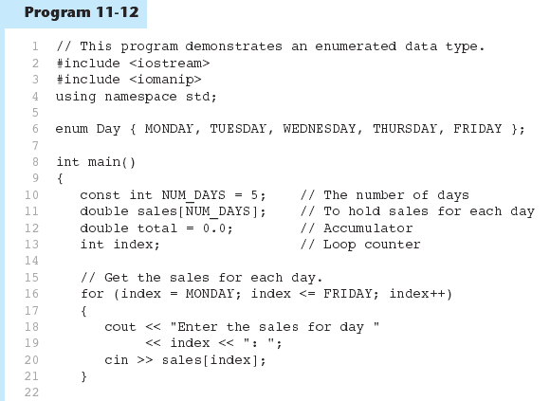

Slide 54
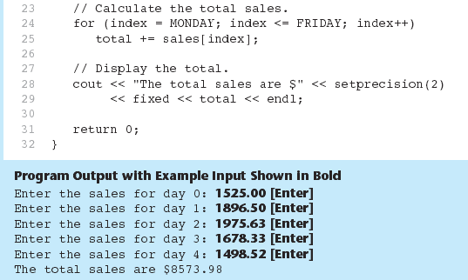
Program 11-12 (Continued)

Slide 55
Enumerated Data Types
Program 11-12 shows enumerators used to control a loop:
// Get the sales for each day.
for (index = MONDAY; index <= FRIDAY; index++)
{
cout << "Enter the sales for day "
<< index << ": ";
cin >> sales[index];
}

Slide 56
Anonymous Enumerated Types
An anonymous enumerated type is simply one that does not have a name. For example, in Program 11-13 we could have declared the enumerated type as:
enum { MONDAY, TUESDAY,
WEDNESDAY, THURSDAY,
FRIDAY };

Slide 57
Using Math Operators with enum Variables
You can run into problems when trying to perform math operations with enum variables. For example:
Day day1, day2; // Define two Day variables.
day1 = TUESDAY; // Assign TUESDAY to day1.
day2 = day1 + 1;// ERROR! Will not work!
The third statement will not work because the expression day1 + 1 results in the integer value 2, and you cannot store an int in an enum variable.

Slide 58
Using Math Operators with enum Variables
You can fix this by using a cast to explicitly convert the result to Day, as shown here:
// This will work.
day2 = static_cast<Day>(day1 + 1);

Slide 59
Using an enum Variable to Step through an Array's Elements
Because enumerators are stored in memory as integers, you can use them as array subscripts. For example:
enum Day { MONDAY, TUESDAY, WEDNESDAY,
THURSDAY, FRIDAY };
const int NUM_DAYS = 5;
double sales[NUM_DAYS];
sales[MONDAY] = 1525.0;
sales[TUESDAY] = 1896.5;
sales[WEDNESDAY] = 1975.63;
sales[THURSDAY] = 1678.33;
sales[FRIDAY] = 1498.52;

Slide 60
Using an enum Variable to Step through an Array's Elements
Remember, though, you cannot use the ++ operator on an enum variable. So, the following loop will NOT work.
Day workDay; // Define a Day variable
// ERROR!!! This code will NOT work.
for (workDay = MONDAY; workDay <= FRIDAY; workDay++)
{
cout << "Enter the sales for day "
<< workDay << ": ";
cin >> sales[workDay];
}

Slide 61
Using an enum Variable to Step through an Array's Elements
You must rewrite the loop’s update expression using a cast instead of ++:
for (workDay = MONDAY; workDay <= FRIDAY;
workDay = static_cast<Day>(workDay + 1))
{
cout << "Enter the sales for day "
<< workDay << ": ";
cin >> sales[workDay];
}

Slide 62
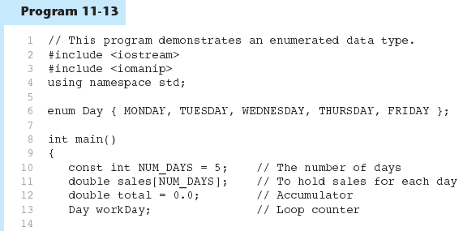

Slide 63
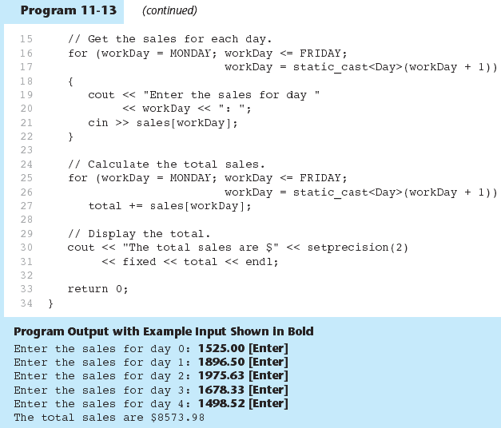

Slide 64
Enumerators Must Be Unique Within the same Scope
Enumerators must be unique within the same scope. (Unless strongly typed)
For example, an error will result if both of the following enumerated types are declared within the same scope:
enum Presidents { MCKINLEY, ROOSEVELT, TAFT };
enum VicePresidents { ROOSEVELT, FAIRBANKS,
SHERMAN };
ROOSEVELT is declared twice.

Slide 65
Declaring the Type and Defining the Variables in One Statement
You can declare an enumerated data type and define one or more variables of the type in the same statement. For example:
enum Car { PORSCHE, FERRARI, JAGUAR } sportsCar;
This code declares the Car data type and defines a variable named sportsCar.

Slide 66
enum Animals {RODENT, CAT, DOG, SHEEP}
void main()
{
  Animals inPatient;
  string animalName;
  cin >> animalName;
  switch(toupper(animalName.at(0)))
  {
  case ‘R’: inpatient = RODENT; break;
  case ‘C’: inpatient = CAT; break;
  case ‘D’: inpatient = DOG; break;
  default: inpatient = ‘SHEEP’
  }
  switch(inPatient)
  {
  case RODENT : cout << “Rodent”; break;
  case CAT : cout << “Cat”; break;
  case DOG : cout << “Dog”; break;
  case SHEEP : cout << “Sheep”;
  }
}

Slide 67
Practice
Declare an enumeration type of the 9 planets in their orders by distance from the Sun. Hint: Mercury, Venus, Earth, Mars, Jupiter…
Write a For statement that prints out the names of the enumeration type declared in

